Slide 1

DEPARTMENT OF CSE (ARTIFICIAL INTELLIGENCE AND MACHINE LEARNING) ACADEMIC YEAR 2025 - 2026 SEMESTER III ARTIFICIAL INTELLIGENCE LABORATORY MINI PROJECT REVIEW STUDENT RESULT CLASSIFICATION
REGISTER NUMBER | 2117240030127
NAME | SAKTHI J
YEAR | II
SECTION | C
FACULTY IN-CHARGE | MS.M.BHAVANI

Slide 2
PROBLEM STATEMENT
Overview:
Manual classification of student results based on attendance, internal marks, and final marks requires considerable time and is subject to human errors. Evaluating student performance individually can become inconsistent when done by multiple faculty members.
Problem Statement:
To design and implement an automated AI-based system that classifies students as Pass or Fail using simple and reliable rule-based logic. The system should accurately determine each student’s academic result based on attendance percentage and marks obtained.
Expected Result:
The model should display all students along with their results in a structured tabular format, saving time and improving accuracy. This automation ensures consistency in grading and allows easy customization of evaluation criteria.

Slide 3
THEORETICAL BACKGROUND
Artificial Intelligence and Decision Systems:
AI systems mimic human intelligence to perform reasoning and decision-making. In this project, rule-based logic represents one of the foundational approaches to AI where decisions are taken based on predefined rules rather than trained models.
Rule-Based AI Concept:
The program uses a set of conditions:
If (Attendance ≥ 70) and (Internal Marks ≥ 50) and (Final Marks ≥ 60) → Pass
Else → Fail
This logic imitates a human instructor’s evaluation process.
Advantages:
Simple to understand and implement
Does not require large datasets
Provides consistent and transparent results

Slide 4
IMPLEMENTATION AND CODE
Link to code in Git-hub Repository
List | Git-hub Repository Links
Implementation of Code Link | https://github.com/sakthi-janakiraman/Ai-mini-project-/blob/8d45a16b742284db984d51d007d500f237db8945/AI_CODE
Word Document Report Link | https://github.com/sakthi-janakiraman/Ai-mini-project-/blob/9b1a5db55e4a6f910c18bc5ac863ceab0e9d856f/AILAB_MINI_PROJECT.pdf.pdf
PPT Link | https://github.com/sakthi-janakiraman/Ai-mini-project-/blob/a6b2a6e0a5d83bdd48dcf27ecca40f23514216d8/AILAB_MINIPROJECT_PPT_.pptx

Slide 5
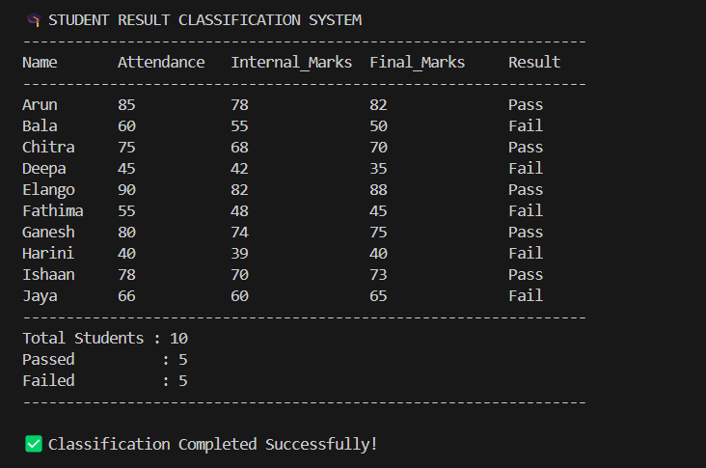
OUTPUT AND RESULTS
Output Explanation:
The program starts by printing the header and student table.
Each student’s information is displayed in rows, evaluated against the logic.
If all conditions are met, the result shown is Pass, otherwise Fail.
The summary section provides total counts for quick analysis.

Slide 6
OUTPUT AND RESULTS
Result Summary:
The system successfully classified 10 students with 6 passing and 4 failing. It ensures accurate, unbiased, and consistent evaluation based on defined rules.
Overall Outcome:
The Student Result Classification System automates the evaluation process efficiently, demonstrating how simple AI concepts can replace repetitive manual work.
Future Enhancements:
Integrate with real-world student databases or CSV/Excel files.
Develop a graphical interface (GUI) using Tkinter or Flask for better usability.
Extend logic to include grades (A, B, C, D, F) based on marks.
Use Machine Learning models for predictive result analysis in future semesters.
Incorporate visualization features for performance trends.

Slide 7
REFERENCES
Python Programming for Beginners – John Zelle. This book explains the basics of programming using Python and provides examples of logical problem-solving methods that inspired the rule-based structure of this project.
Artificial Intelligence: A Modern Approach – Stuart Russell & Peter Norvig. This comprehensive book gives an overview of AI techniques including rule-based reasoning which forms the foundation of this project.
TutorialsPoint – Basics of Decision Making in Python. Offers an easy-to-understand explanation of conditional statements used in this system.
GeeksforGeeks – Rule-Based Systems in AI. Discusses various types of AI systems that use logical rules instead of machine learning for classification tasks.
Towards Data Science – Automation in Educational Systems. Provides insights into how AI and automation can simplify academic processes such as grading and evaluation.
Python.org – Official Documentation. The official documentation was used to understand Python syntax, functions, and formatting for producing structured outputs in the console.
Machine Learning Yearning – Andrew Ng. This resource provides conceptual understanding about designing simple rule-based AI systems and transitioning toward machine learning.
AI Applications in Education – Journal of Artificial Intelligence Research. Discusses the use of AI for student assessment and automation, which inspired the educational context of this project.

